Slide 1
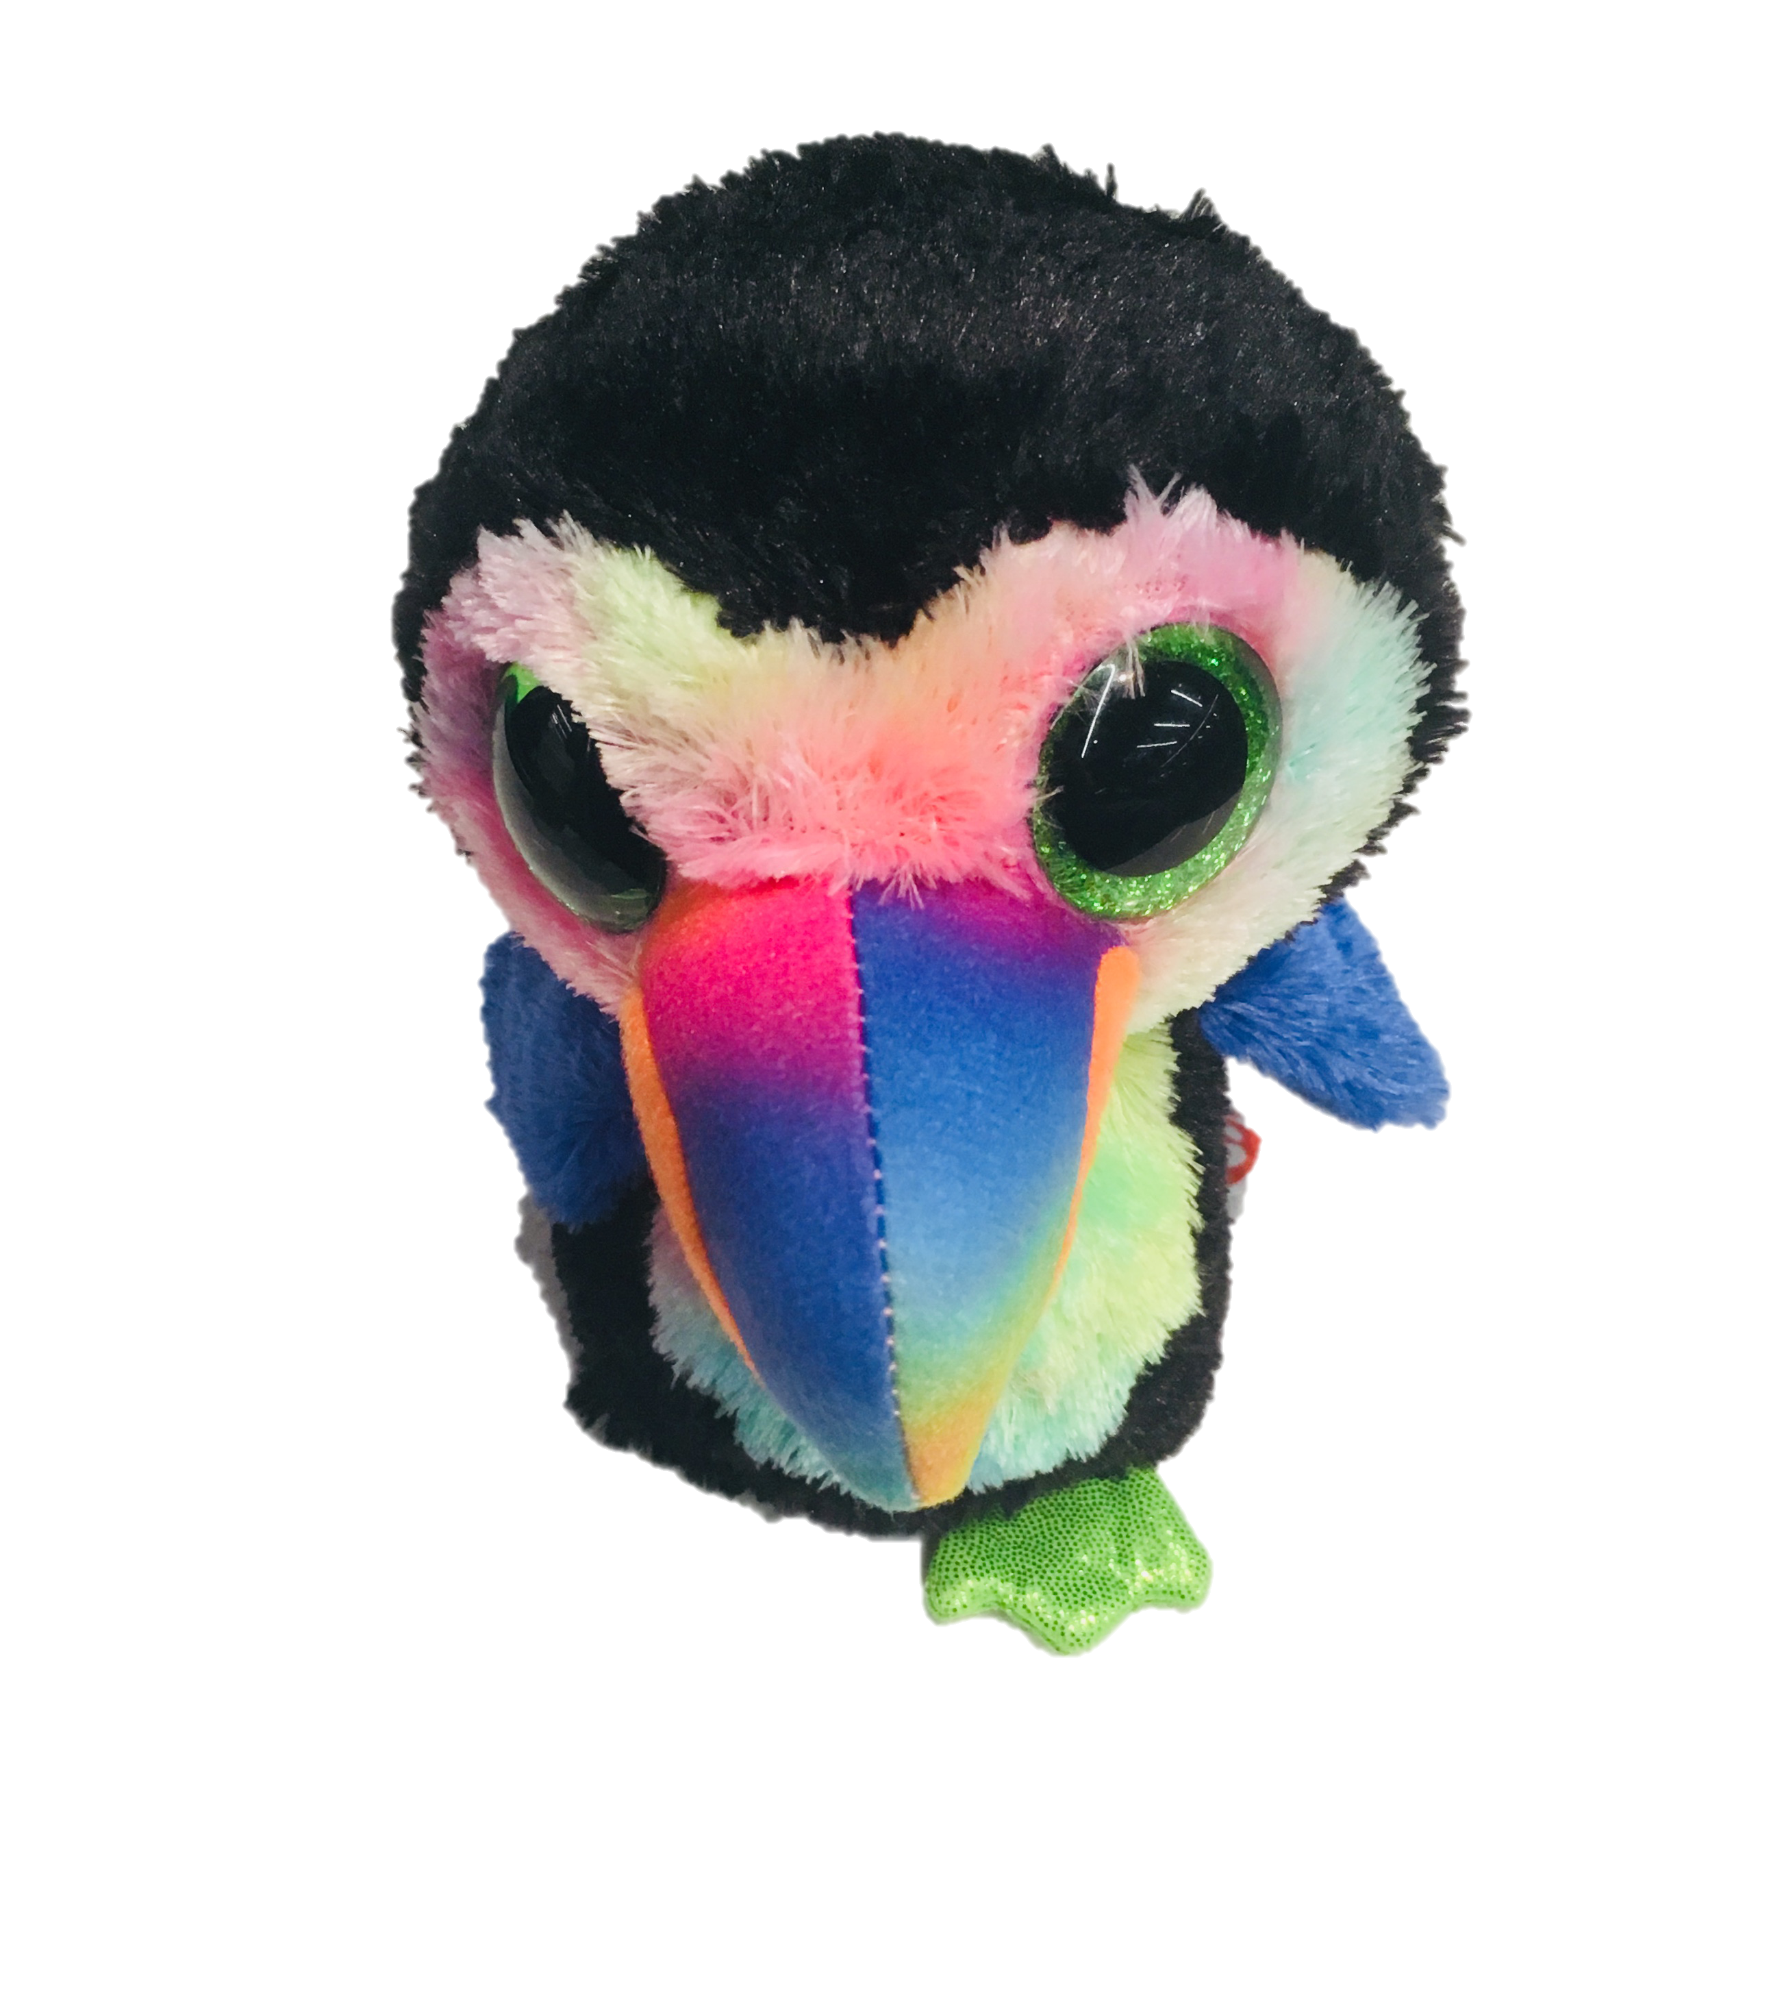
Advanced oTree
Philipp Chapkovski
European University Institute
University of Mainz
June 4-5, 2018
Custom models – Public Good Game

Slide 2
PGG with punishment stage
2 stages:
Contribution
Punishment
at Punishment stage participants observe decisions at Contribution stage.
They can’t spend more than they have

Slide 3
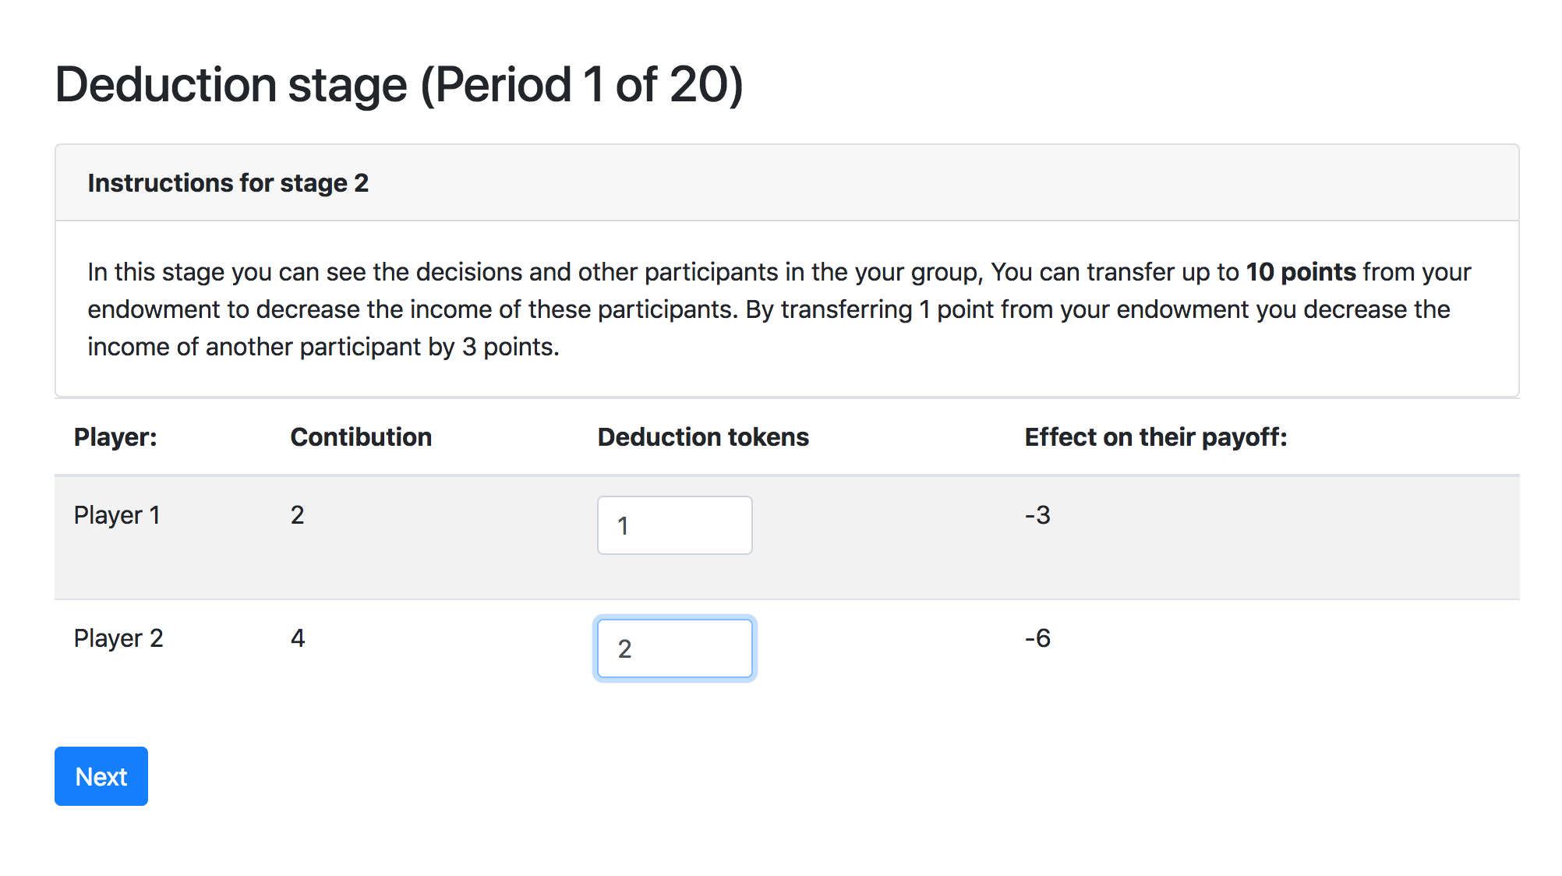
Our Task:

Slide 4
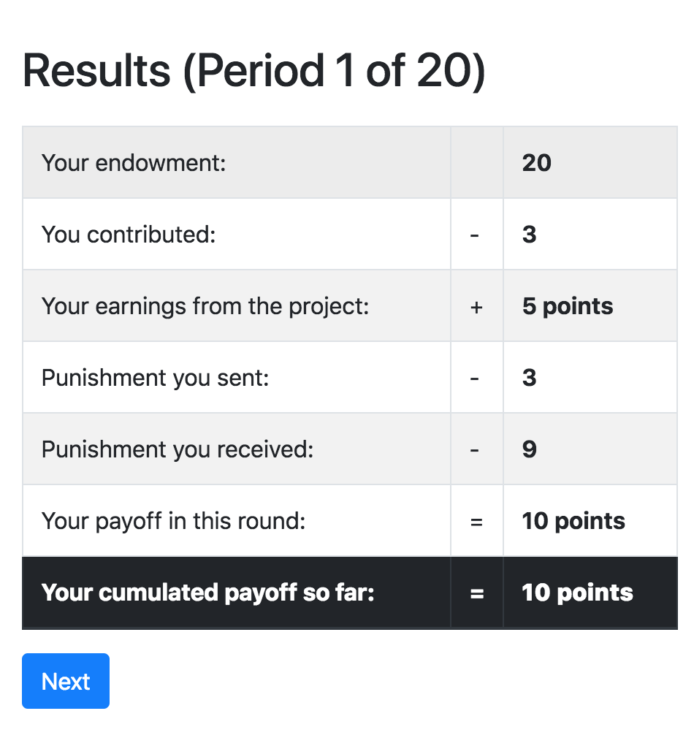
Our Task:

Slide 5
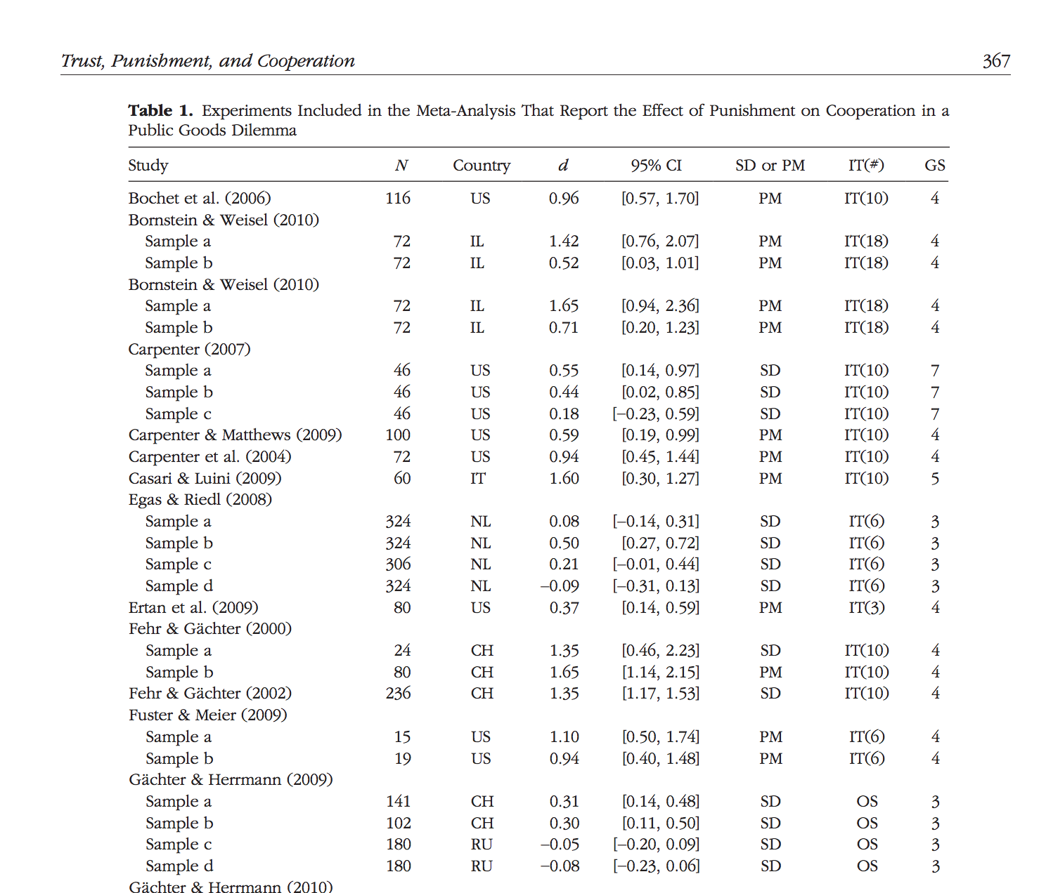
Balliet, D., & Van Lange, P. A. (2013). Trust, punishment, and cooperation across 18 societies: A meta-analysis. Perspectives on Psychological Science, 8(4), 363-379.

Slide 6
Our Task:
Scalable code (from 3 to 6 players)
Getting info about punishment sent and received
At Punishment stage show them contributions of others
Do not let them spend more than X in total on punishment
Leaving an option to run PGG without punishment under some treatments

Slide 7
Two ways of doing it
Using ‘normal’ oTree fields
Using custom models

Slide 8
getattr, setattr
If you need to set or get an attribute of a class (model?) you can use
getattr(ClassName, AttributeName)
print(self.player.contribution)
print(getattr(self.player,’contribution’)
setattr(ClassName, AttributeName, Value)
where AttributeName is a string

Slide 9
Punishment fields
pun1, pun2, pun3, pun4, pun5, pun6 = [models.CurrencyField() for i in range(6)] def set_payoff(self): self.payoff = self.pd_payoff - self.punishment_sent - self.punishment_received def set_punishment(self): puns_sent = [getattr(self,'pun{}'.format(p.id_in_group)) for p in self.get_others_in_group()] self.punishment_sent = sum(puns_sent) puns_received = [getattr(p, 'pun{}'.format(self.id_in_group)) for p in self.get_others_in_group()] self.punishment_received = sum(puns_received) * Constants.punishment_factor

Slide 10
zip
You can create two dimensional arrays in Python (aka tables in normal life) using zip
zip(a, b) creates an array with two columns, and n rows
you can loop through them by:
a = [1, 2, 3] b = ['a', 'b', 'c'] for i, j in zip(a, b): print(i, j)

Slide 11
Punishment page
class Punishment(Page): form_model = 'player' def get_form_fields(self): return ['pun{}'.format(p.id_in_group) for p in self.player.get_others_in_group()] def vars_for_template(self): others = self.player.get_others_in_group() form = self.get_form() data = zip(others, form) return {'data': data} def error_message(self, values): tot_pun = sum([int(i) for i in values.values()]) if tot_pun > self.player.punishment_endowment: return 'You can\'t send more than {} in total'.format(self.player.punishment_endowment)

Slide 12
Punishment tempate
<table class="table table-hover table-striped"> <thead> <tr> <th>Player:</th> <th>Contibution</th> <th>Deduction tokens</th> </tr> </thead> {% for i,j in data %} <tr> <td>Player {{ forloop.counter }}</td> <td>{{ i.contribution }}</td> <td>{% formfield j label='' %}</td> </tr> {% endfor %} </table>

Slide 13
Extra info
get form fields in vars_for_template
def vars_for_template(self): form = self.get_form()
get field id on template:
{{ field_name.id_for_label }}

Slide 14
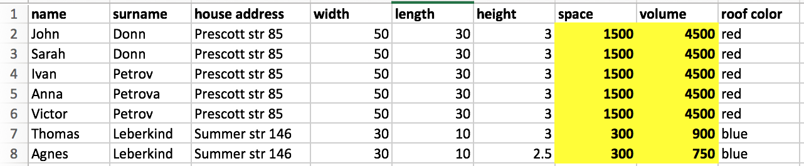
ForeignKey relational databases
we can split the data sheet into two tables (Persons, Houses) and the information stops being redundant

Slide 15
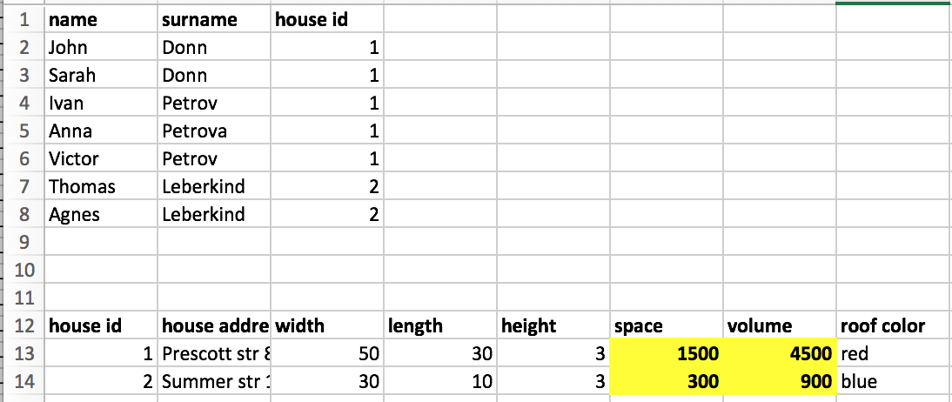
ForeignKey relational databases
we can split the data sheet into two tables (Persons, Houses) and the information stops being redundant

Slide 16
ForeignKey relational databases
class definition: structure of the data:
class instance: the specific ‘record’ of the data

Slide 17
Django Database structure
Subsession
Participant
Session
Group
Player

Slide 18
Django ORM
from otree.models import Session, Participant
class Intro(Page): def is_displayed(self): cursession = Session.objects.get(pk=self.session.pk) participants = cursession.participant_set.all() for p in participants: print(p.code) # Results in the same output as: for p in self.session.get_participants(): print(p.code)

Slide 19
Stage 1: Contribution
Player | Contribution | Payoff after Stage 1
P1 | 10 | 130
P2 | 20 | 120
P3 | 30 | 110
P4 | 40 | 100
Endowment: 100
Coefficient: 1.6

Slide 20
Stage 2: Punishment
Sender | Receiver | Amount
P1 | P2 | 0
P2 | P3 | 5
P3 | P4 | 10
P2 | P1 | 2
P2 | P3 | 3
P2 | P4 | 0
Max punishment endowment: 20
Punishment factor: 3

Slide 21
a model linking senders and receivers
class Punishment(djmodels.Model): sender = djmodels.ForeignKey(to=Player, related_name='punishments_sent') receiver = djmodels.ForeignKey(to=Player, related_name='punishments_received') amount = models.IntegerField(null=True, )

Slide 22
Creating punishment records
class Subsession(BaseSubsession): def creating_session(self): for p in self.get_players(): for o in p.get_others_in_group(): Punishment.objects.create(sender=p, receiver=o, )

Slide 23
Setting max punishment payoff
class Player(BasePlayer): …. def set_punishment_endowment(self): assert self.pd_payoff is not None, 'You have to set pd_payoff before setting punishment endowment' self.punishment_endowment = min(self.pd_payoff, Constants.punishment_endowment)

Slide 24
Formset factory
we create a new file called forms. there we make our formset factory:
PFormset = inlineformset_factory(Player, Punishment, formset=PunishmentFormset, extra=0, can_delete=False, fk_name='sender', fields=['amount']) formset paratemeter is NOT necessary.
we need it to check that amount of total punishments is less than punishment endowment

Slide 25
formset
class PunishmentFormset(BaseInlineFormSet): def clean(self): super().clean() if any(self.errors): return amounts = [] punishment_endowment = self.instance.punishment_endowment for form in self.forms: amounts.append(form.cleaned_data['amount']) if sum(amounts) > punishment_endowment: raise ValidationError( "In total you can't send more than {endowment} points!".format( endowment=punishment_endowment))

Slide 26
anatomy of oTree
every page (and many views in Django) has get and post methods
They are executed when a page is shown, and when the form is submitted correspondingly
on get oTree checks the is_displayed and redirects further if it is false
on post oTree checks the errors in a form, executes before_next_page and redirects further

Slide 27
page Punishment
class Punishment(Page): def vars_for_template(self): return {'formset': PFormset(instance=self.player)} def post(self): context = super().get_context_data() formset = PFormset(self.request.POST, instance=self.player) context['formset'] = formset context['form'] = self.get_form() if formset.is_valid(): allpuns = formset.save(commit=True) else: return self.render_to_response(context) return super().post()

Slide 28
after everyone has made punishment decisions
class AfterPunishmentWP(WaitPage): def after_all_players_arrive(self): self.group.set_punishments() for p in self.group.get_players(): p.set_payoff()

Slide 29
setting punishment
class Group(BaseGroup): def set_punishments(self): for p in self.get_players(): p.set_punishment()
class Player(BasePlayer): … def set_punishment(self): self.punishment_sent = sum([i.amount for i in self.punishments_sent.all()]) self.punishment_received = sum( [i.amount for i in self.punishments_received.all()]) * Constants.punishment_factor

Slide 30
setting payoffs
class Player(BasePlayer): def set_payoff(self): self.payoff = self.pd_payoff - self.punishment_sent - self.punishment_received

